Slide 1
Topic: Measurement EQ: How do I apply area to hectares?
Year 11 Essentials

Slide 2
Things Required For This Lesson
Interactive Notebook
Textbook: Interleaved Maths Essential Connections
Ruler, Red Pen, Pencil, Pens, Scientific Calculator
Growth mindset

Slide 3
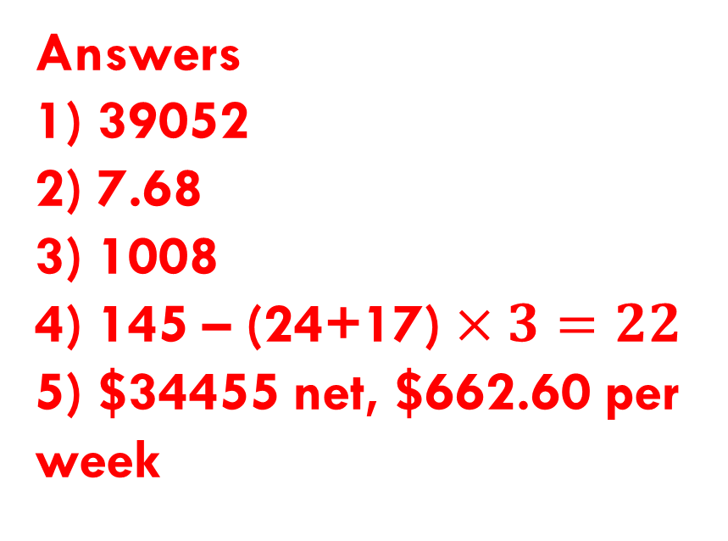
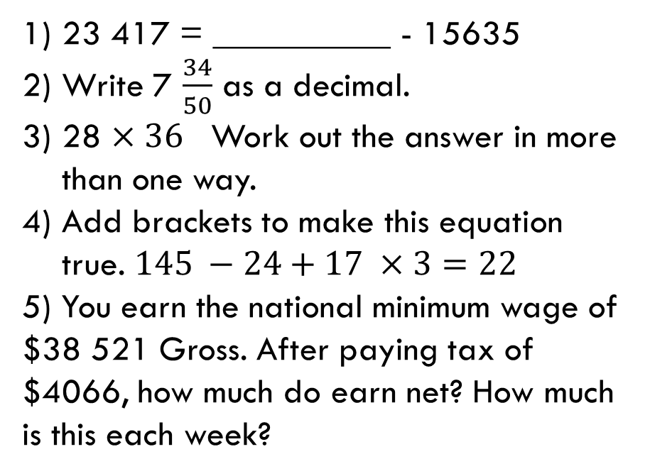
First 5
Answers
1) 39052
2) 7.68
3) 1008
4) 145 – (24+17) $×3=22$
5) $34455 net, $662.60 per week
23 417 = __________ - 15635
Write 7 $\frac{34}{50}$ as a decimal.
28 $×36$ Work out the answer in more than one way.
Add brackets to make this equation true. $145 −24+17 ×3=22$
5) You earn the national minimum wage of $38 521 Gross. After paying tax of $4066, how much do earn net? How much is this each week?

Slide 4

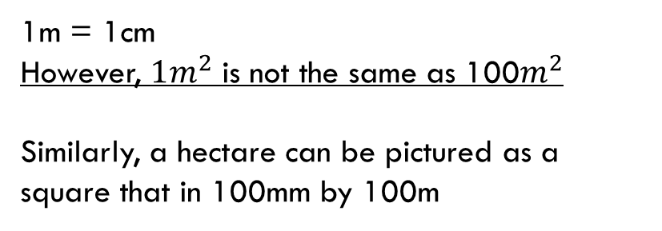








24
7
30
Topic: Measurement
EQ: How do I apply area to hectares?
1m = 1cm
However, $1m^{2}$ is not the same as 100$m^{2}$
Similarly, a hectare can be pictured as a square that in 100mm by 100m
$$1m$$
$$1m$$
$$1m^{2}$$
$$10m$$
When converting from or too hectares we divide or multiply by 1000
$$10m$$
$$100m^{2}$$
$$100m$$
$$100m$$
$$1000m^{2}$$
WICOR

Slide 5
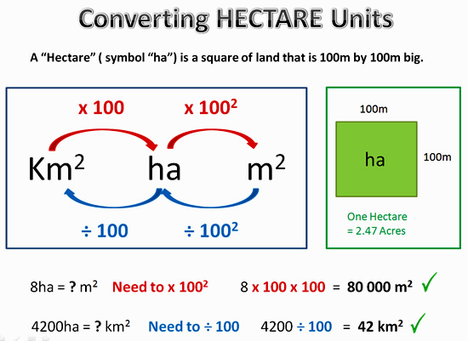
24
7
30
Topic: Measurement
EQ: How do I apply area to hectares?
How to convert to hectares?
WICOR

Slide 6
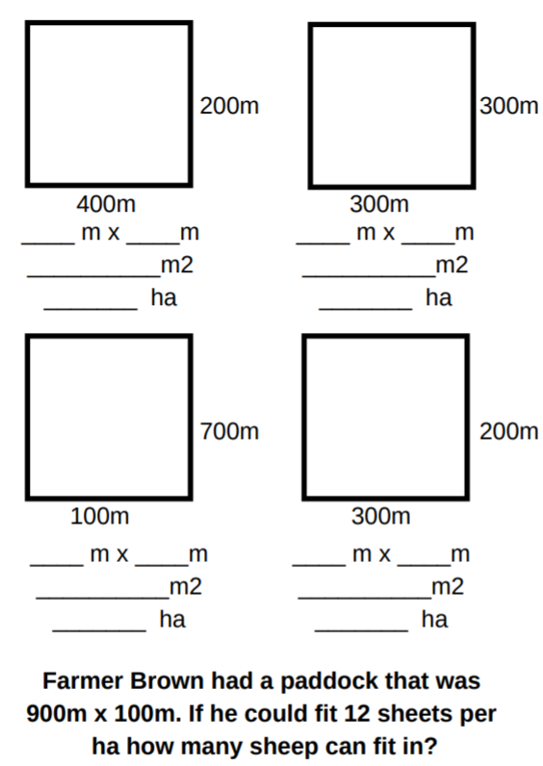
24
7
30
Topic: Measurement
EQ: How do I apply area to hectares?
Have a go at these questions
1.
2.
3.
4.
5.
WICOR

Slide 7
Page 65
Use laptops to complete questions on page 65, comparing land sizes.
Apply your knowloedge
Compare land sizes and prices between Perth, Baldivis and regional towns. Show the difference in the prices. Explain the reasoning behind why there is/isn’t price differences

Slide 8

Thank you
Keep up the good work!

